Slide 1
Bank Marketing
Rana Gamal

Slide 2
The marketing campaigns were based on phone calls.
Problem statement
The data of direct marketing campaigns of a Portuguese banking institution.
Often, more than one contact to the same client was required, in order to access if the product (bank term deposit)

Slide 3
Objective
Deploy a ML Model to predict if the customer will accept for the marketing campaign or not.

Slide 4
Project analysis slide 2
Data Summary
17 Features & 45,248 Rows
37 Duplicated rows
4 columns have nulls
Classification problem

Slide 5
Project analysis slide 4
Data Features
Default
Balance
Previous
Age
Duration
Tasks
Contact
Education
Job
Marital
Campaign
Implementation Plan
Schedules
Target
Customer Objectives
Marital
Poutcome
Day
Resources

Slide 6
Project analysis slide 2
Data Preprocessing
Drop Duplicates
Drop columns with nulls > 50%
Fill nulls in Categorical column using Mode
One Hot Encoder for cat. columns

Slide 7
Project analysis slide 2
Data Preprocessing
Robust scalar for scaling
Under sampling for Imbalanced Classes
Robust scalar for scaling
Extract duration in months col.

Slide 8
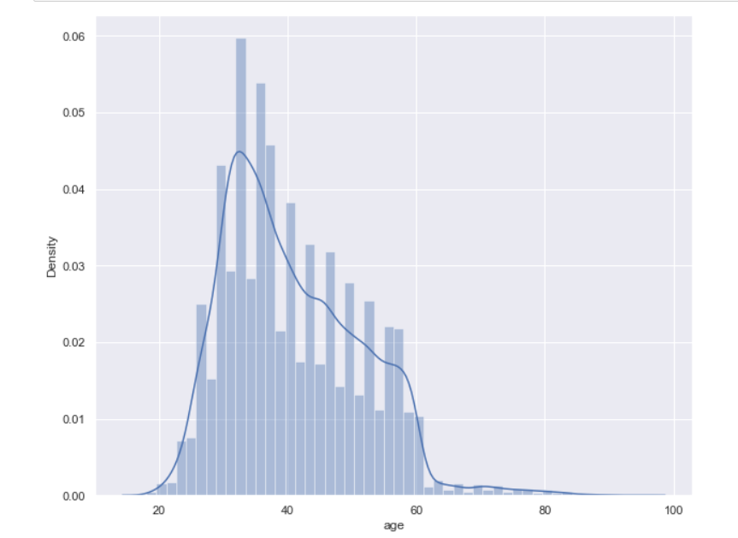
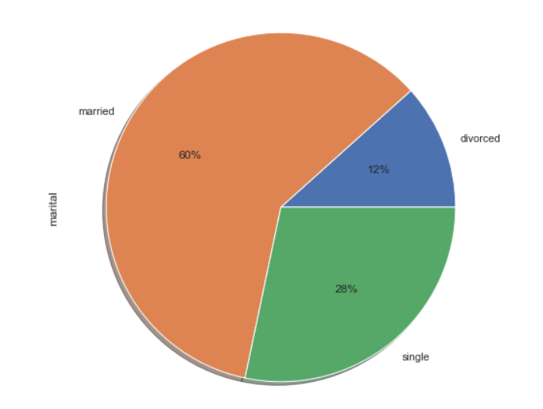
Project analysis slide 8
Analysis
Age distribution
Marital Pie Chart

Slide 9
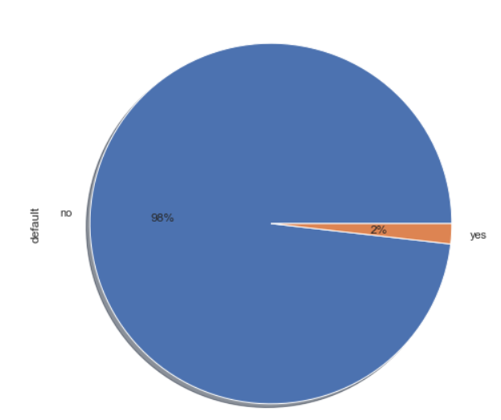
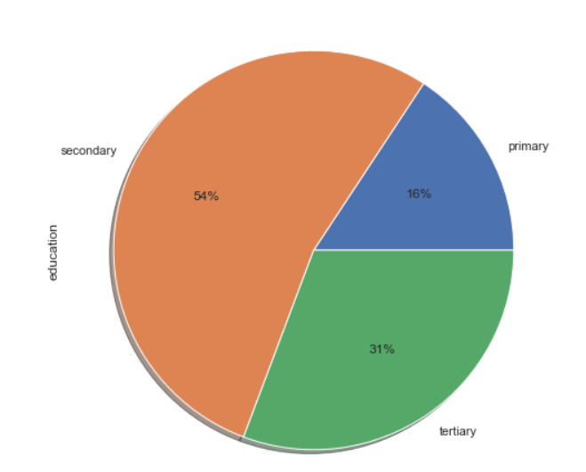
Project analysis slide 8
Analysis
Education Pie Chart
Default Pie Chart

Slide 10
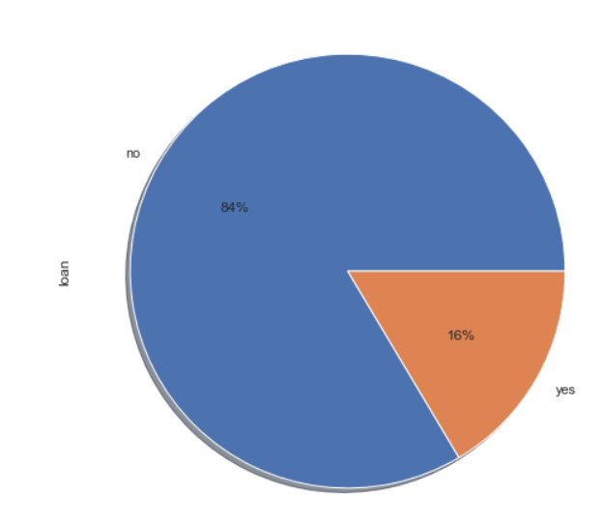
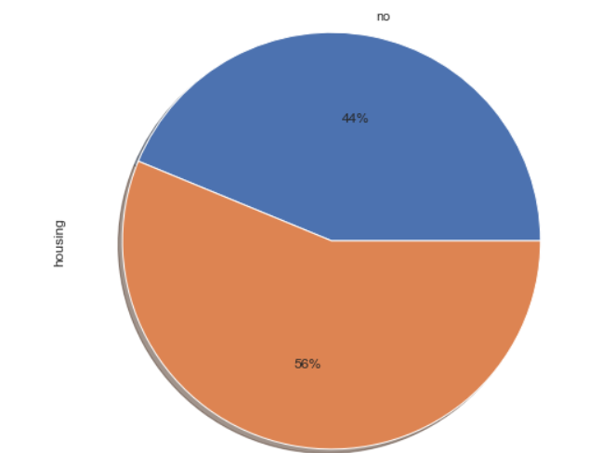
Project analysis slide 8
Analysis
Housing Pie Chart
Loan Pie Chart

Slide 11
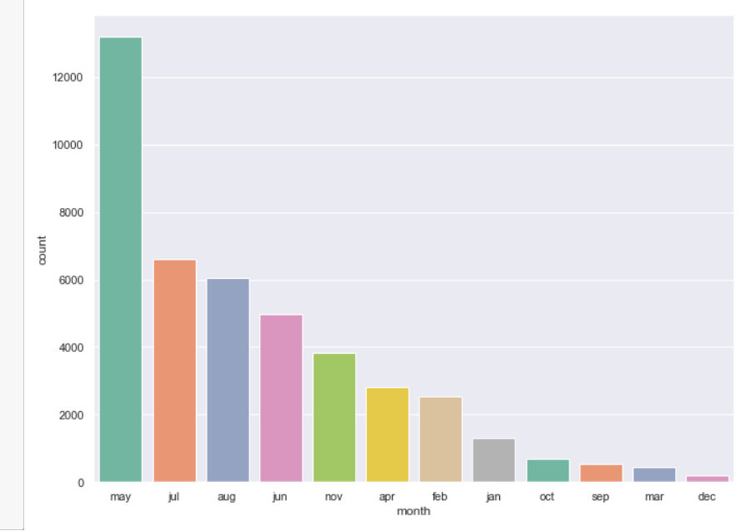
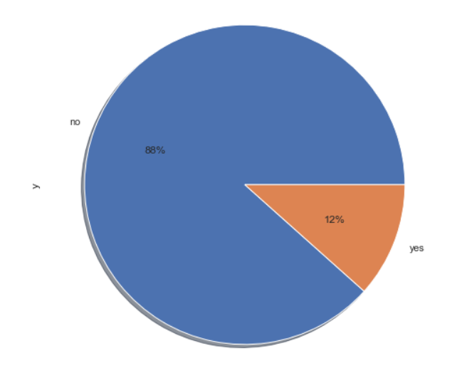
Project analysis slide 8
Analysis
Target Pie Chart
Most calls are in May

Slide 12
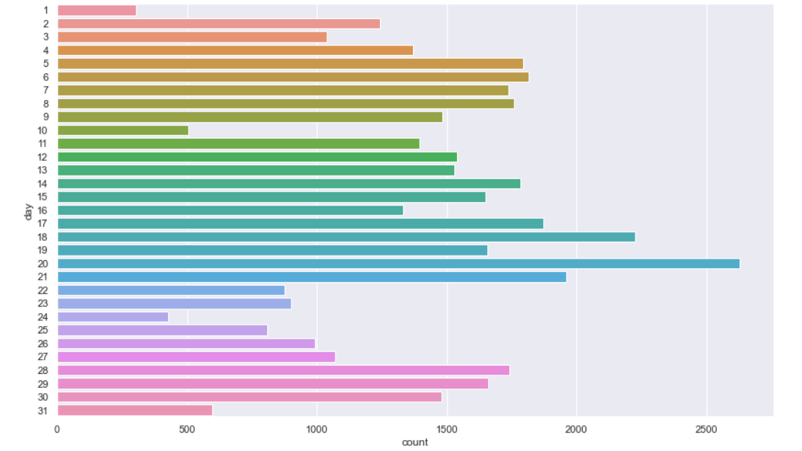
Project analysis slide 8
Analysis
Most calls are in 20th of the Month

Slide 13
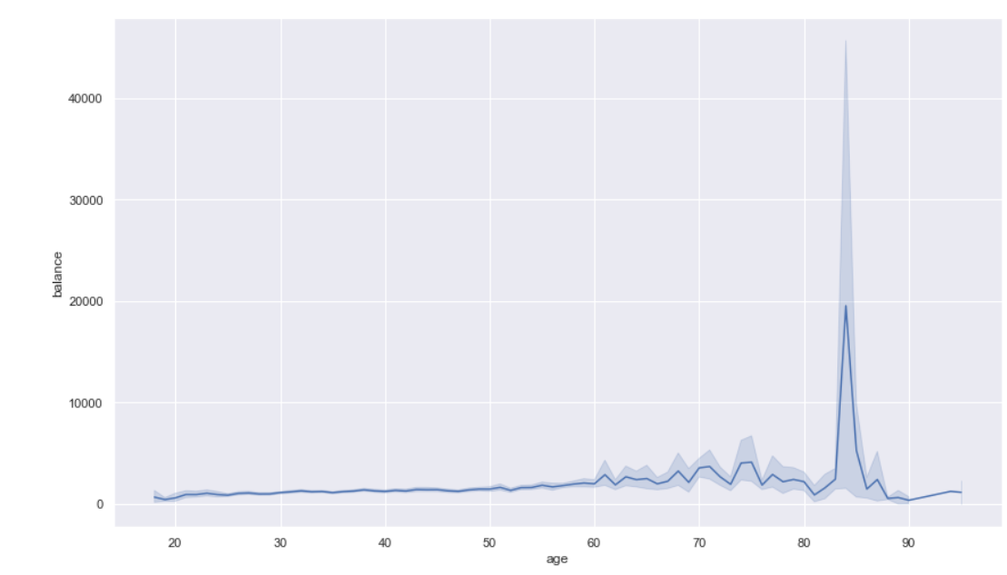
Project analysis slide 8
Analysis
Higher Balance is for ages >80

Slide 14
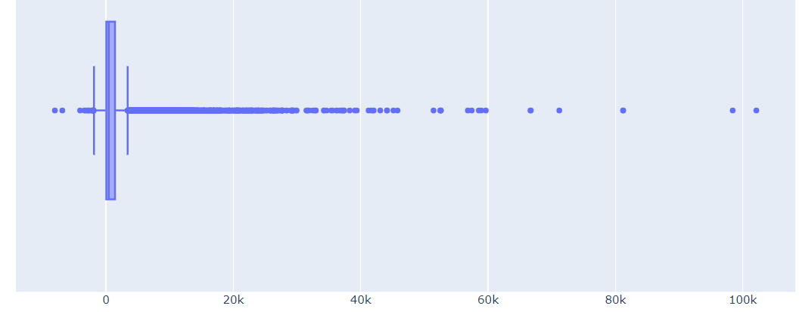
Project analysis slide 8
Analysis
Balance boxplot

Slide 15
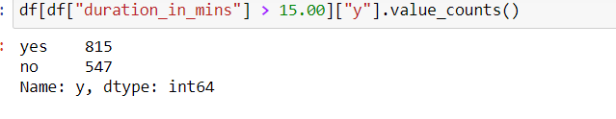
Project analysis slide 8
Analysis
The Outcome when the duration >15 mins

Slide 16
ML Model
RandomForestClassifier with accuracy of 85.6%

Slide 17
Deployment
Streamlit for Deployment

Slide 18
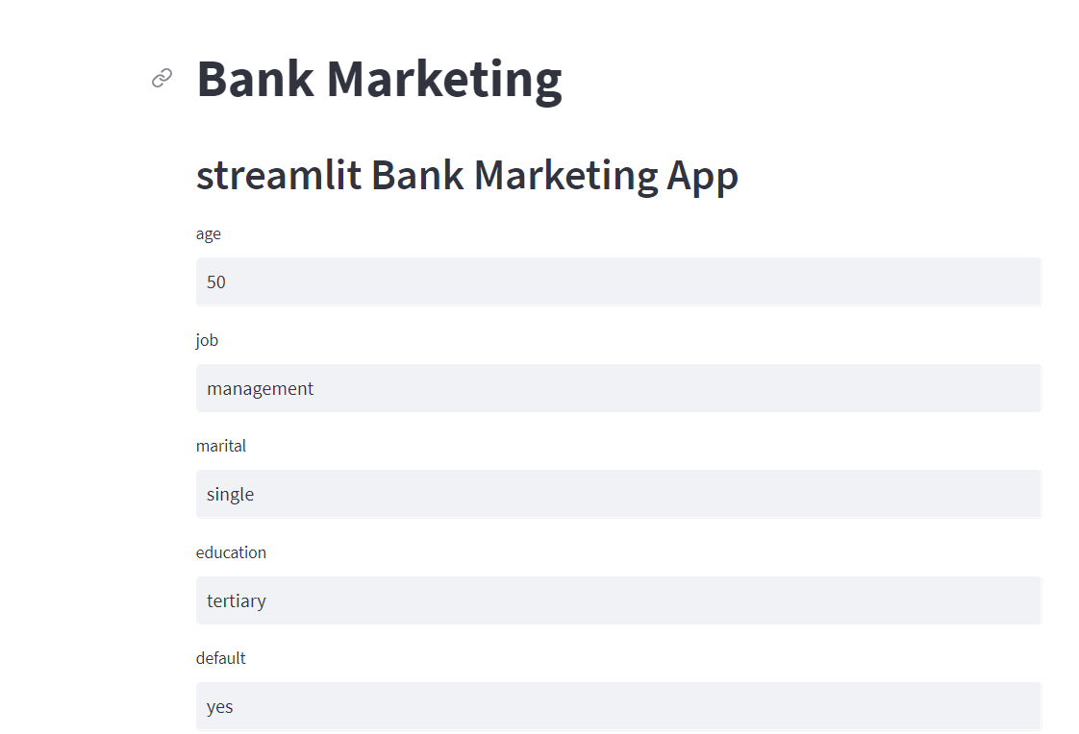
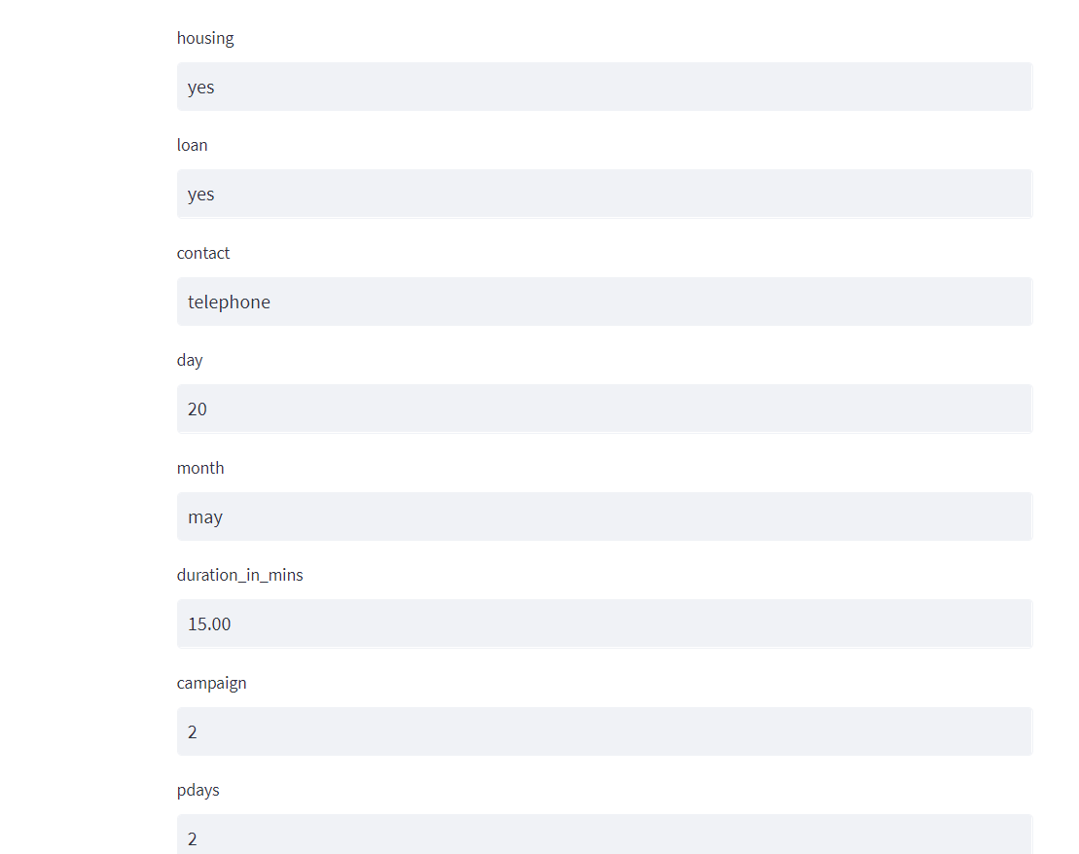
Deployment

Slide 19
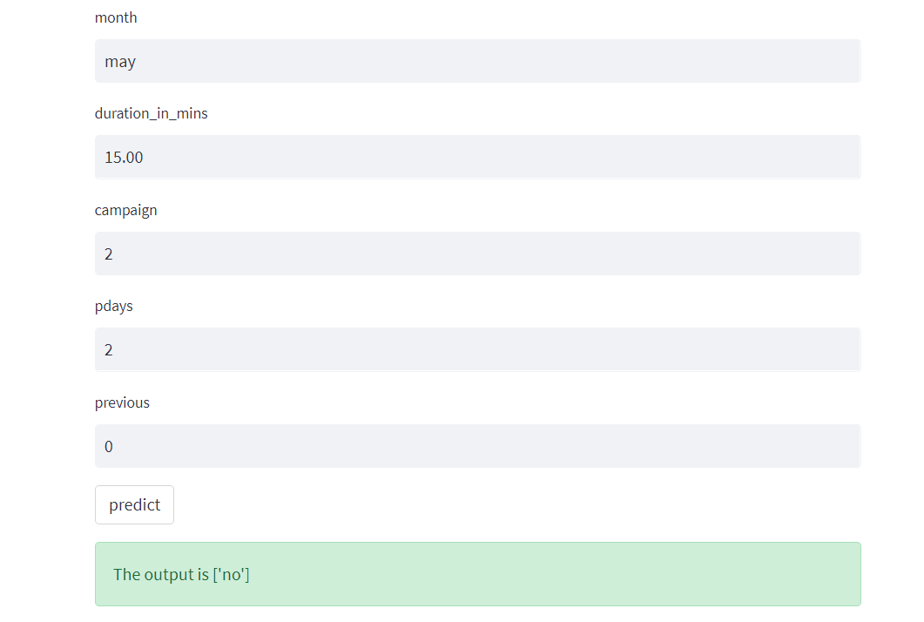
Deployment

Slide 20
Thank You

